Slide 1

Refugee Aid MANAGEMENT System
2
+
2
+

Slide 2


Introduction
2
+
2
+
We as a team had a common interest to work on social issues which will make an impact on people and society.
The topic chosen is with a thought of developing an application for helping the refugees with their basic problems.

Slide 3

Problem Statement
2
+
2
+
2
+

Slide 4

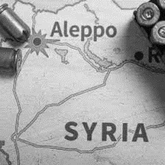
The purpose of this project is to provide aid to people who are affected during civil wars/ natural calamities so they have no resources with them.
These destructed areas have a scarcity of food, medical aid, shelter. It is a humanitarian act to help such mentally and physically affected people.
These people become refugees due to such problems and accommodating them in other countries via immigration becomes important.
For example, the current civil war in Syria which is going on since 7 years has caused a lot of destruction mainly affecting its citizens.
2
+

Slide 5

Approach
2
+
We will be developing a Refugee Aid Management System application that will help the affected people to get the resources (food, shelter, medical aid). The organization employees will register for the refugees who are willing to migrate to different countries. Later this data is handed to a particular embassy which further verifies for the refugee and then this data is sent to the immigration office of the other country.
There is another Aid organization which sends request to different NGOs for the rescue. Here NGOs from different countries can communicate with each other.
This application will be a swing application to simulate how Refugee Aid Management System works for destructed countries.
TeamAED

Slide 6
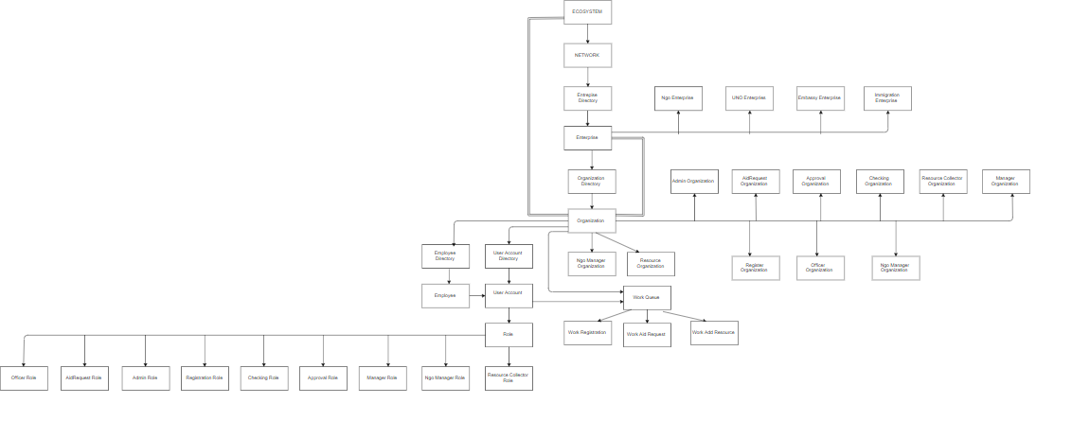
OBJECT MODEL
For Refugee Aid System
TeamAED

Slide 7
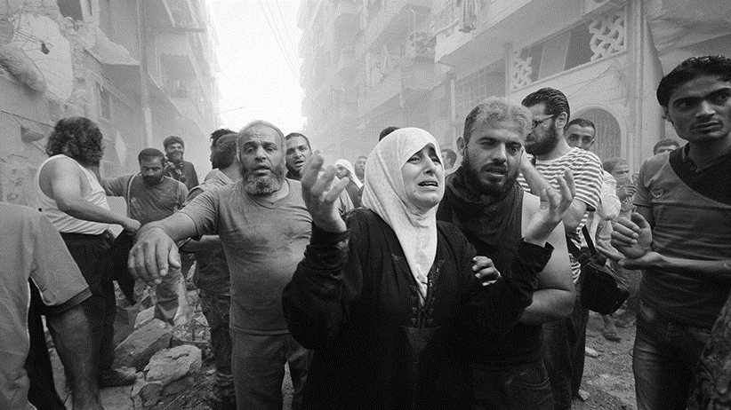
Title
Functionalities
Additional Functionalities
Refugee Registration Screen
Manager Login Screen
Manager Screen to send request Embassy
Checking Screen to check received refugee data from UNO
Approval Screen to send data to immigration office
Visa officer Screen to Reject/Approve Immigration
Serialization and Deserialization
- Used for Refugee details
Google Maps
- To show current location of NGO receiving request
Graphical Representation using Pie Charts
- Representing number of immigrants in particular country
- Representing percentage of countries approving immigration request
Pdf Generation
- Generated with Refugee Details
TeamAED

Slide 8
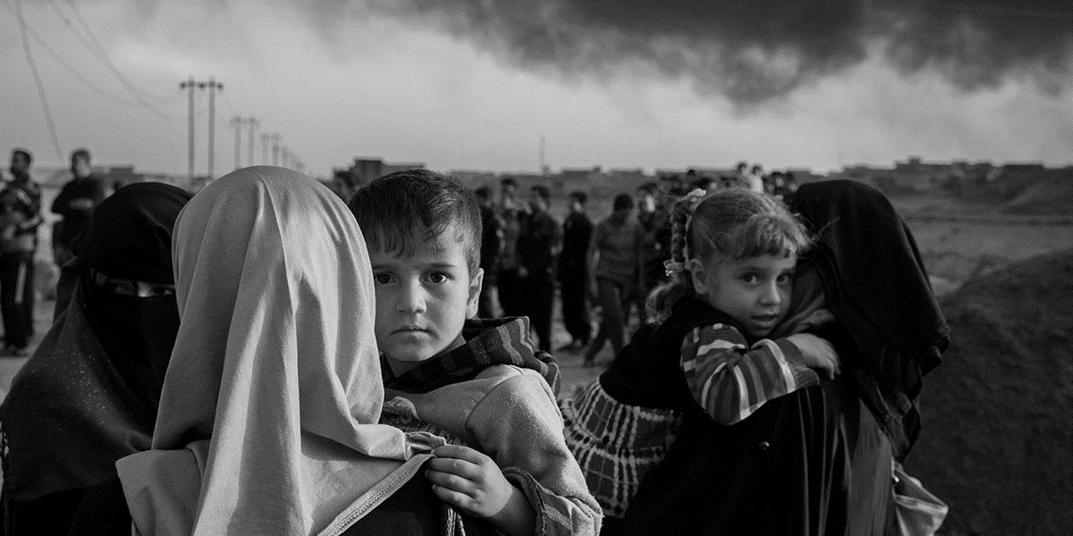
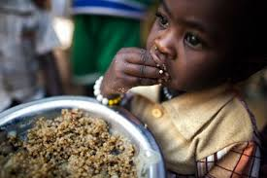
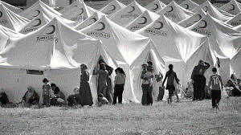
USECASES
1. Registration for Refugees
2. Processing Aid Request
3. Analysis of data and generation of refugee details
TeamAED

Slide 9
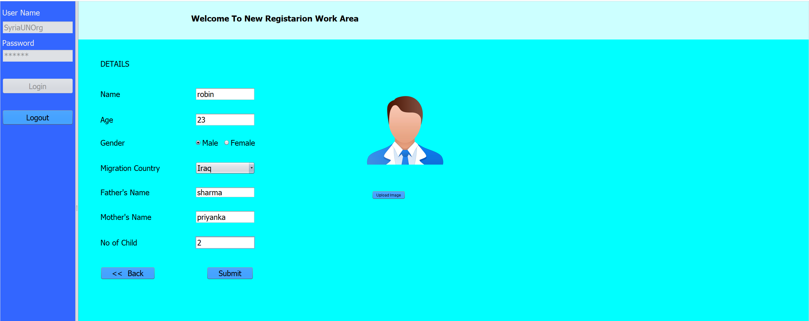
USECASE for Registering Refugees
Employee of registration organization under UNO enterprises registers refugees.
TeamAED

Slide 10
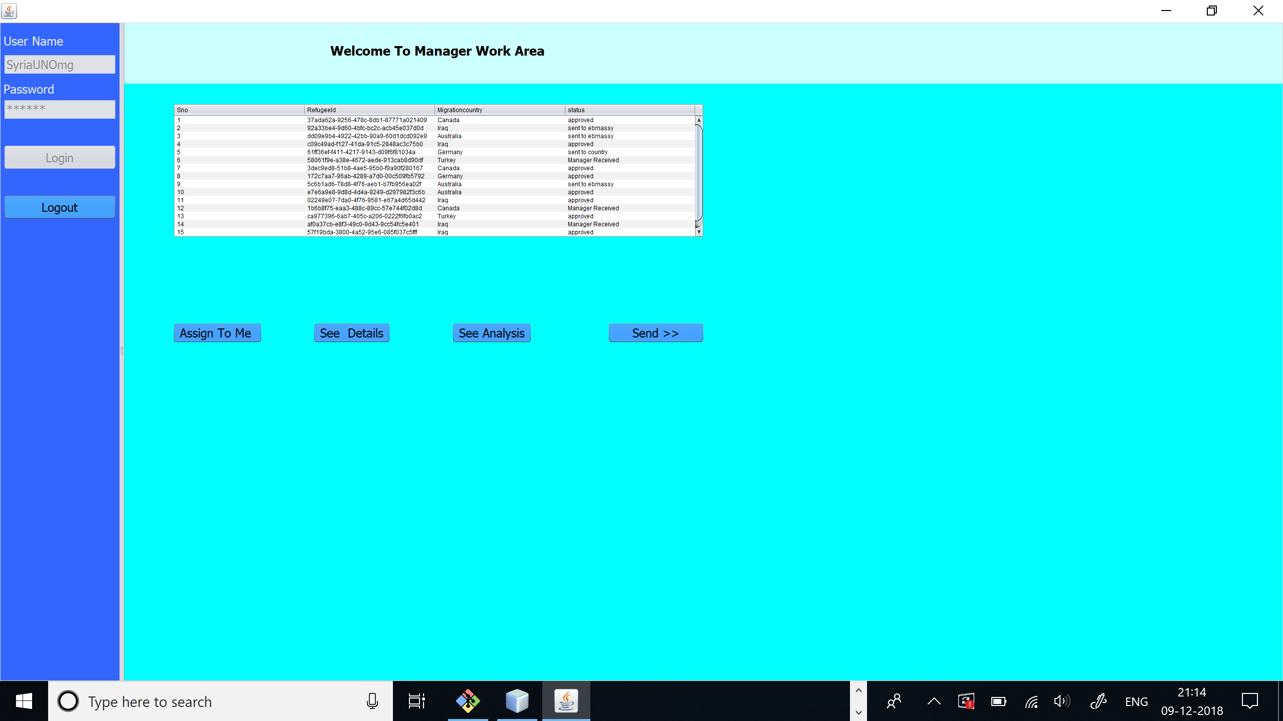
2. Employee of Manager Organization under UNO enterprise will send details to the particular embassy to which refugee wants to migrate.
TeamAED

Slide 11
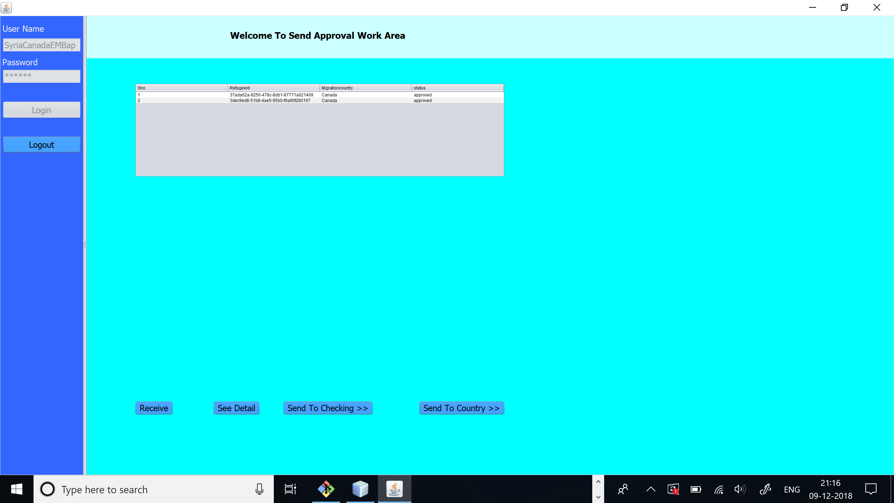
3. These details are received by Approval organization under embassy enterprise of that particular country.
4. Further these details are sent for checking organization of the same embassy
5. Now the embassy will send the details to the immigration office of that country.
TeamAED

Slide 12
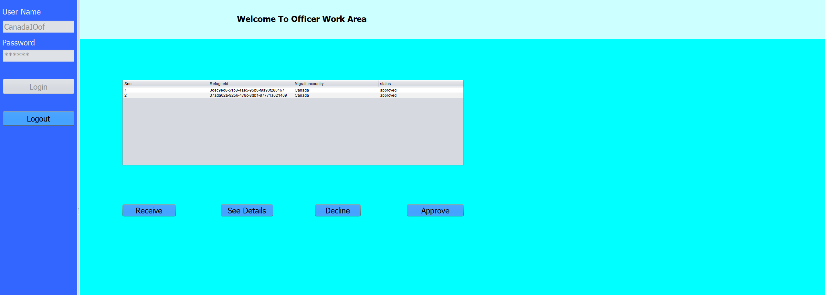
6. The immigration officer will approve/decline the request.

Slide 13
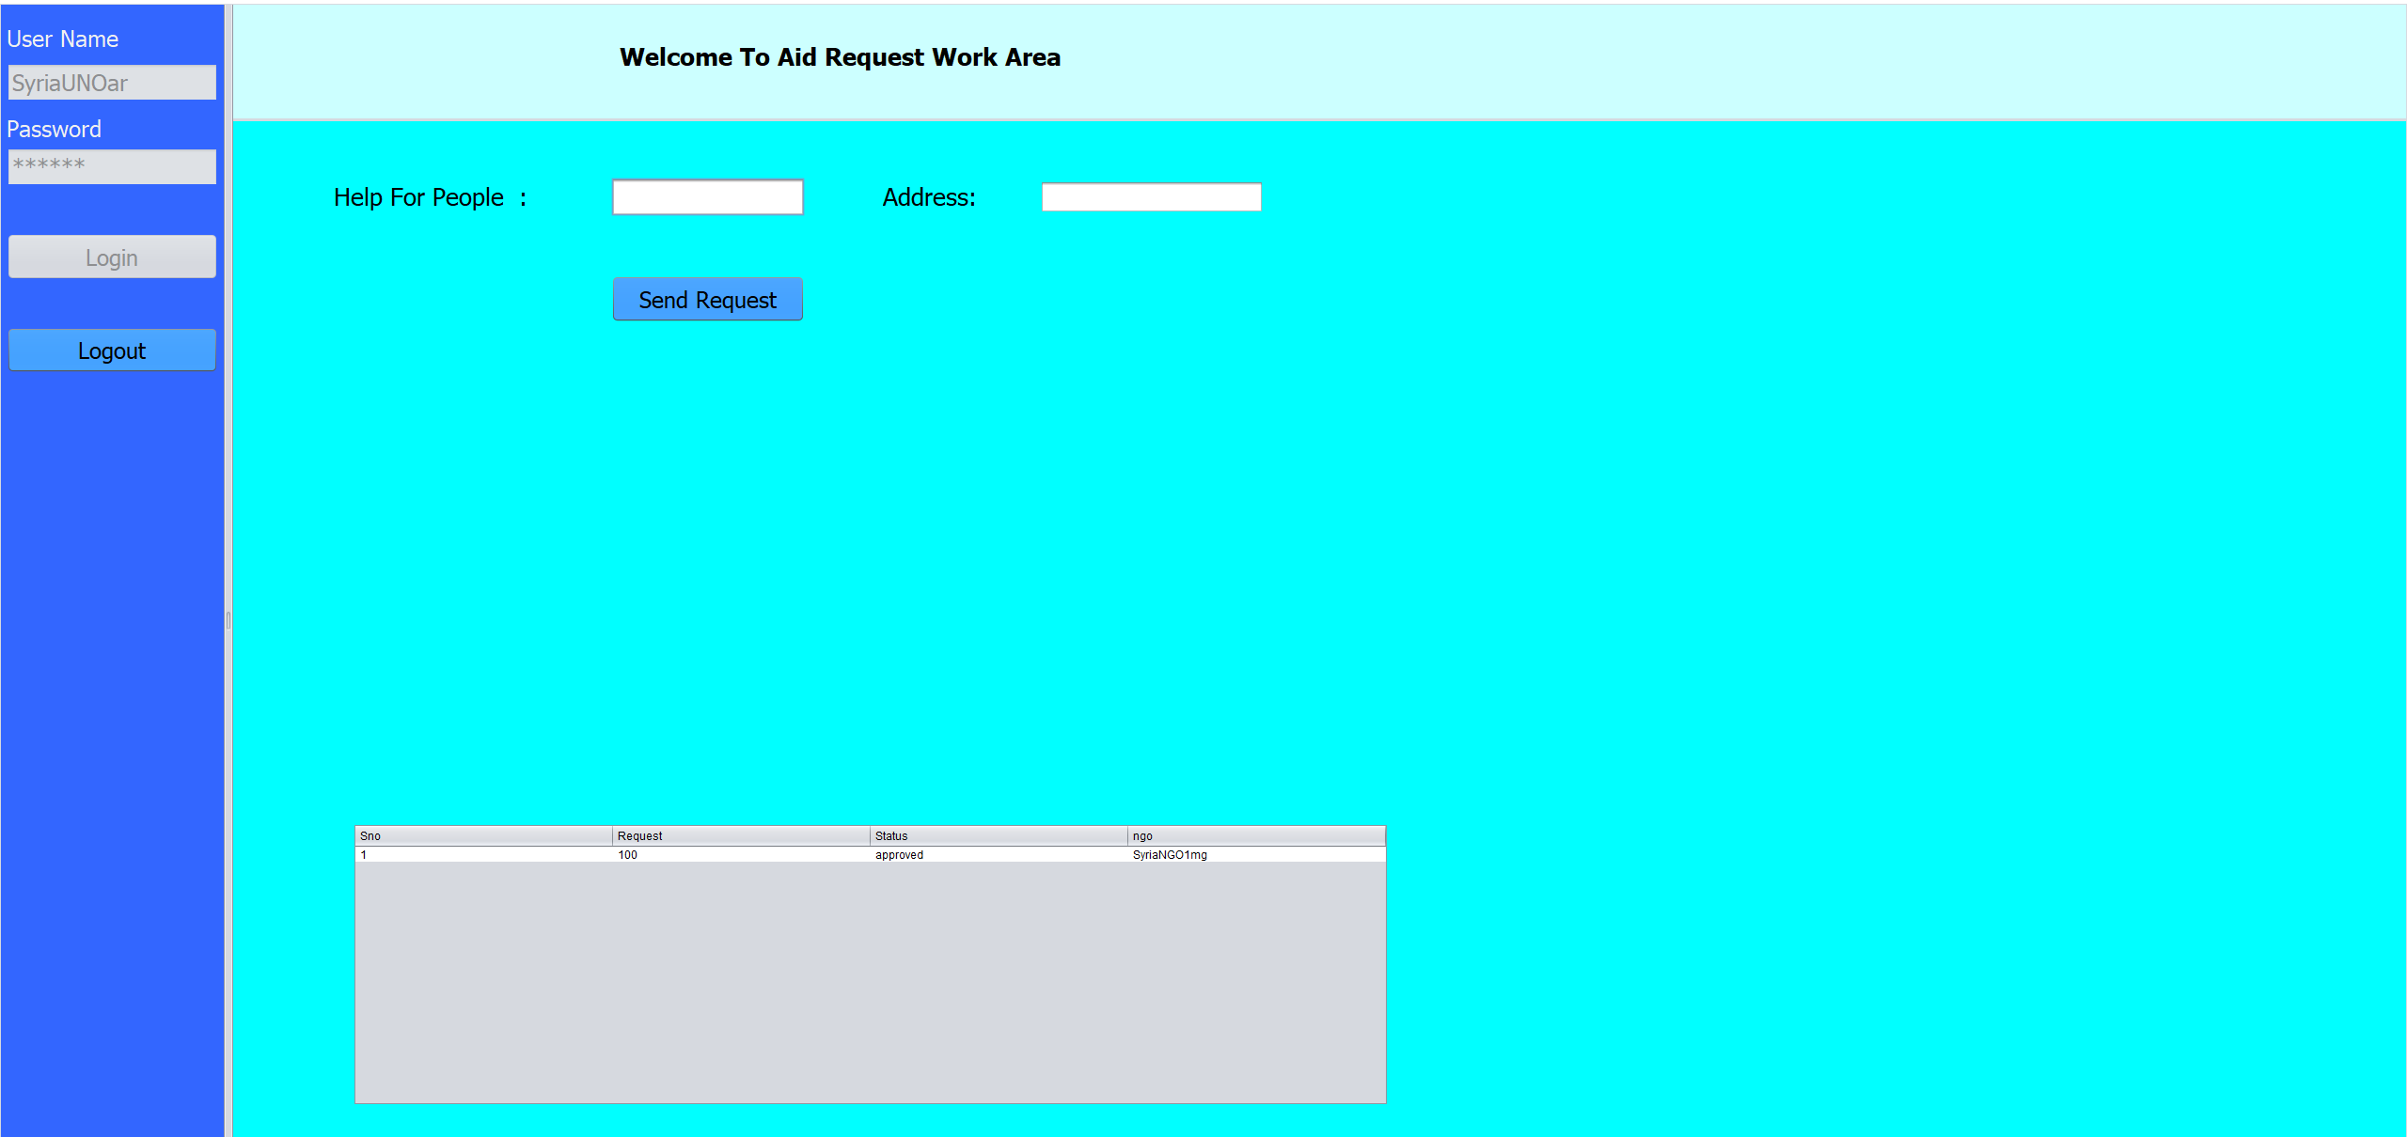
USECASE FOR PROCESSING AID REQUEST
1. The Aid Request Organization in UNO enterprise will send request for aid to different NGOs

Slide 14
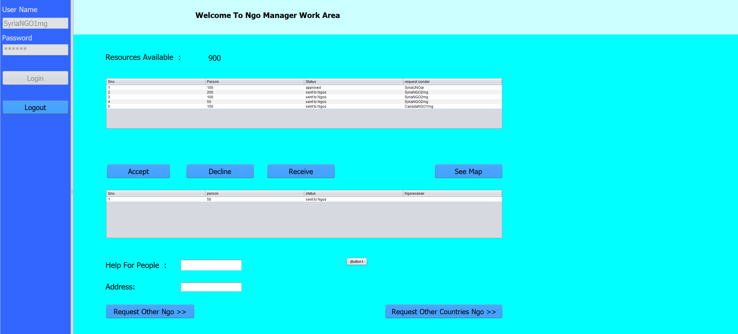
2. NGOs can contact different NGO in same or another network

Slide 15
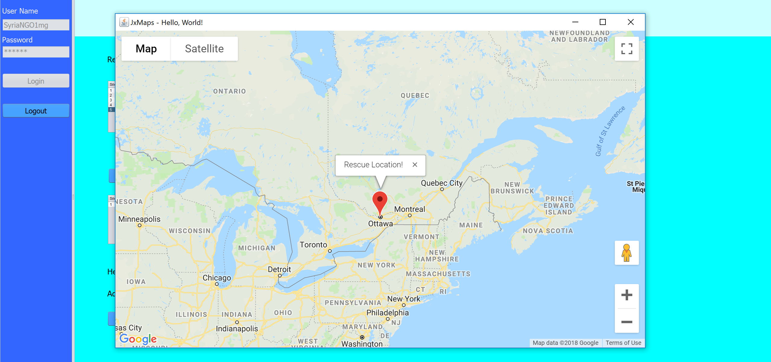
3. NGO can view locations from where the request is coming from
TeamAED

Slide 16
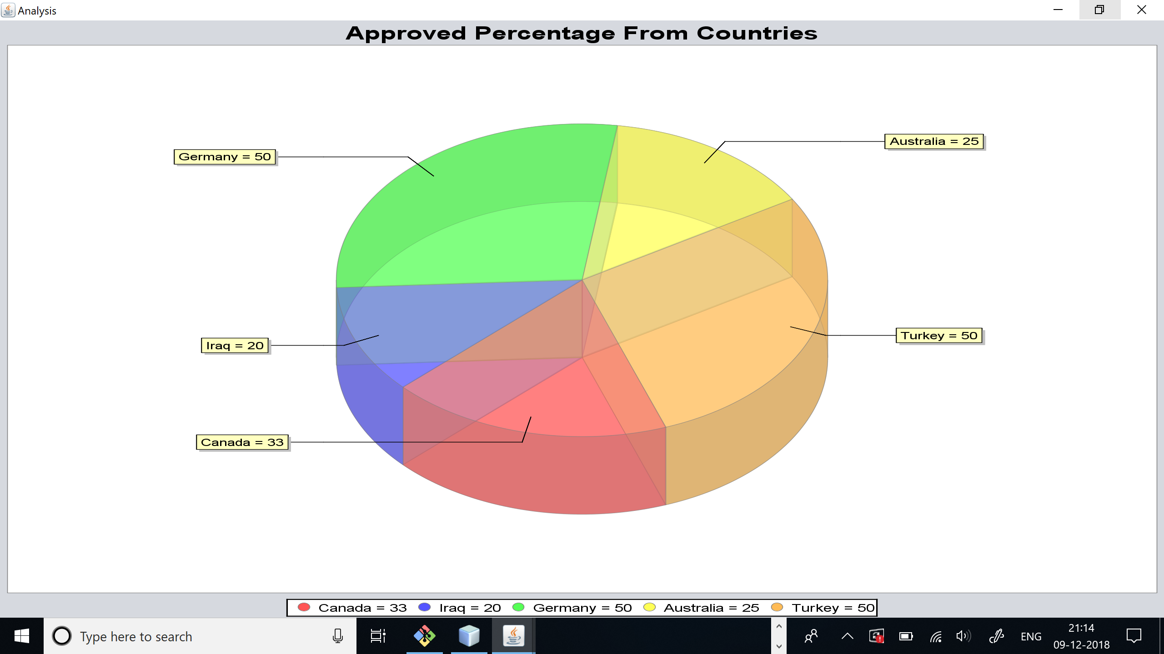
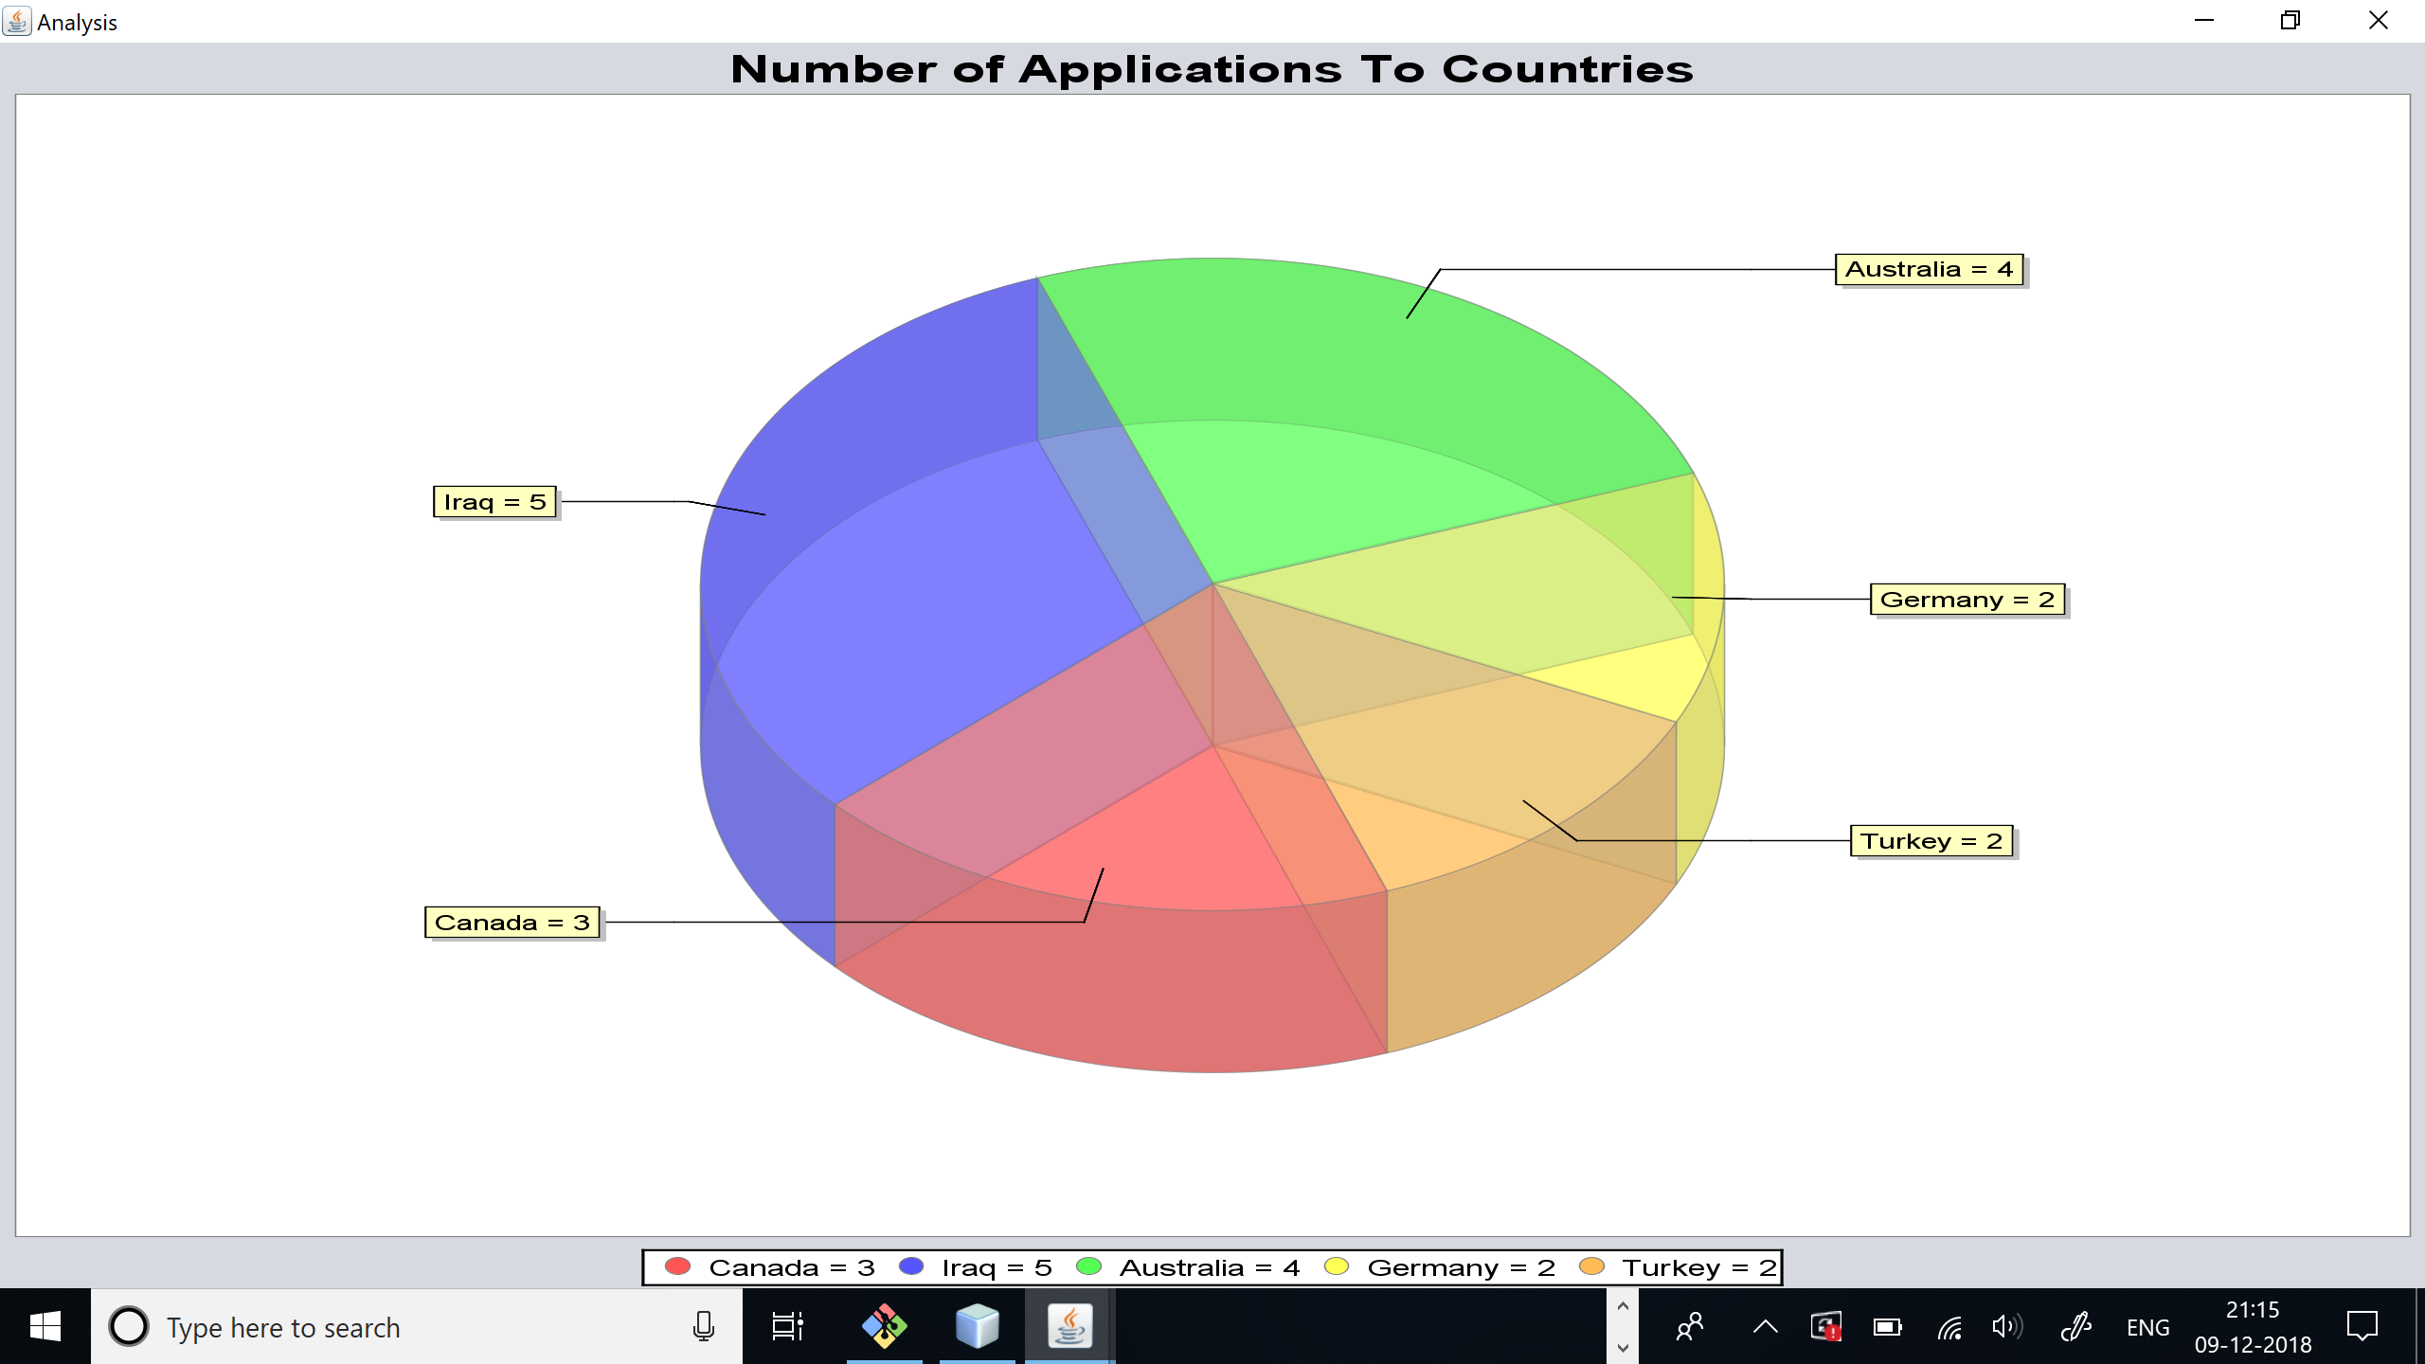
USECASE FOR Analysis of data and generation of refugee details
UNO manager of the country can analyze data for percentage of approvals in a country and number of immigrants in a particular country for future analysis.
TeamAED

Slide 17
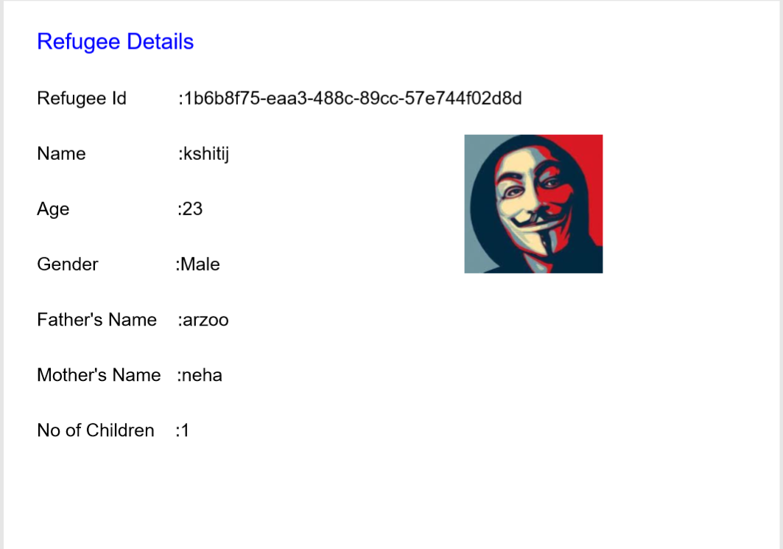
2. Pdf can be generated for registered refugees

Slide 18
Future SCOPE
Volunteering functionality can be included
Can be deployed as a web application or an android application
More entities can be included like education, counselling, jobs for the refugees
TeamAED

Slide 19
References
https://refaid.com/
https://www.youtube.com/watch?v=2852BXYimj4
http://www.vogella.com/tutorials/JFreeChart/article.html
https://www.geeksforgeeks.org/serialization-in-java/
5. https://www.tutorialspoint.com/java/java_serialization.htm
TeamAED

Slide 20
THANK YOU
2
+
2
+

